Slide 1
Welcome

Slide 2
Summary:
A brief statement or account of the main points of something.
Theme:
the subject of a talk, piece of writing, exhibition, etc
Question no -3 - Summary- 10 marks (Prose / Poetry) (Textual or Non textual )
Question no- 11- Theme -8 marks (Prose / Poetry) (Textual or Non textual )

Slide 3
Theme Could be a sentence or even a word Underlying meaning ( Authors message) Could be an interpretation or opinion on a particular topic Could be out of text Can vary from person to person | Summary A passage of main points ( Usually one third) Explicit story Factual recollection of what actually happen ( No personal opinion) Strict to text Fixed to everyone

Slide 4
Tips for writing theme and summary:
Underline the key words
Start by your own words.
Do not quote original sentences
Ensure plain and direct statements
Avoid details, examples and instances, interrogatives , exclamations and quotations
Must have one single paragraph
For summery ----Actually rewrite the story / poem in short in your own words.
For theme right the hidden opinion or message of the poem/ or story
For summery we can start like this:
. This is the poem/ passage which has been discussed about --------/
The speaker says that ----
For theme we can start like this
In this poem / story we find / notice that

Slide 5
11. Write down the theme of the following poem. (Not more than 50 words) 8 [Unit–10; Lesson–2(2–B)]
Hold fast to dreams
For if dreams die
Life is a broken-winged bird
That cannot fly.
Hold fast to dreams
For when dreams go
Life is a barren field
Frozen with snow.
By- Lagston Hughes

Slide 6
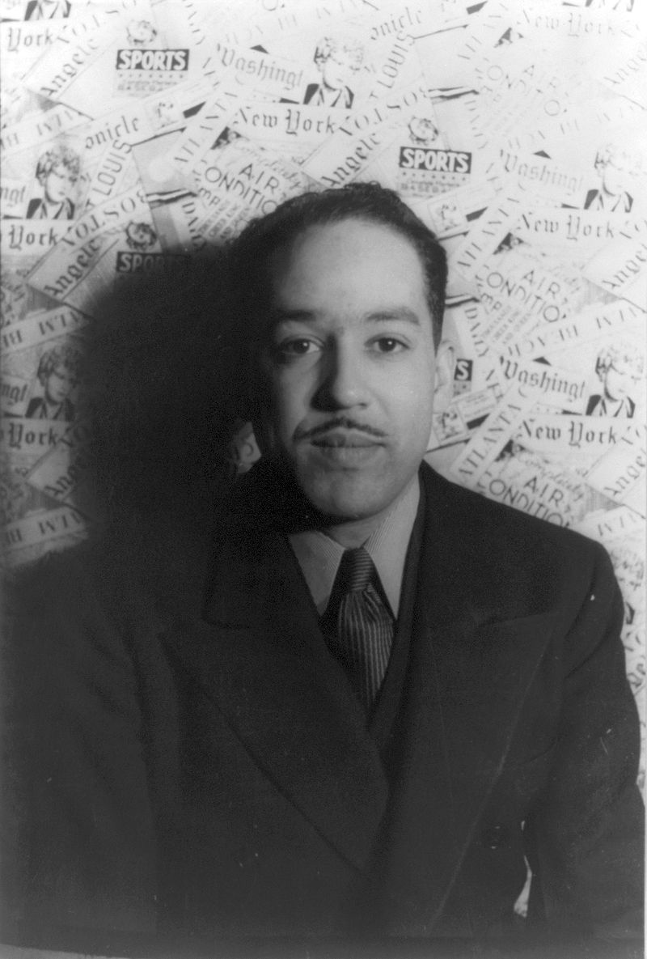
James Mercer Langston Hughes (February 1, 1901– May 22, 1967) was an American poet, social activist, novelist, playwright, and columnist from Joplin, Missouri.

Slide 7
Theme of the poem 'Dreams by Langston Hughes'
In the poem, the poet has highlighted the importance of dreams in our life. Dreams are very essential to approach in our life. Without dreams life is meaningless. No success can be expected from a life having no dream. Dreamless life is like an unfertile land from where nothing is hoped.

Slide 8
Summary of the poem 'Dreams' by Langston Hughes :
Summary : The word dreams in the poem is personified. The life of dreams stands in contrast to the death images that follow. It is the figurative language that gives the poem power. The personification and imagery has been alluded to. Each stanza of the poem contains a metaphor. In the first stanza, life without dream is compared to a broken-winged bird. A broken-winged bird's life is meaningless and has no purpose. In the same way, a life without dreams has no purpose. The second stanza compares a life without dreams to a barren field frozen with snow. A field is created for the purpose of providing life. A barren field does not fulfill its purpose. Similarly a life is created to give and provide life to others A life without dreams is nothing

Slide 9
11. Write down the theme of the following poem. (Not more than 50 words) 8
[Unit–10; Lesson–2(A)]
All people dream, but not equally.
Those who dream by night in the dusty recesses of their mind,
Wake in the morning to find that it was vanity.
But the dreamers of the day are dangerous people,
For they dream their dreams with open eyes,
And make them come true.
By- D. H. Lawrence

Slide 10
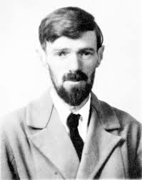
David Herbert Lawrence (11 September 1885 – 2 March 1930) was an English writer and poet. His collected works represent, among other things, an extended reflection upon the dehumanising effects of modernity and industrialisation.

Slide 11
Theme of the poem 'Dreams by D. H. Lawrence'
In the poem the poet has highlighted the importance of dream. Actually, it is very necessary for the development of human civilization. There are two kinds of dreamers. One kind of people dreams in their sleep. The dream of these people is valueless. Such dreams are the representation of unconscious desires and thought. But another types of dreamers dream at daylight. They dream for something very valuable and necessary for the civilization. They have firm determination to materialize their dream and finally become successful.

Slide 12
Summary of the poem 'Dreams' by D. H. Lawrence :
Summary : In this poem, the poet shows the evil purpose of the dreams. The poem has two stanzas. In the first stanza, the poet says that all people dream. Some people dream by night in an unconscious mind. That is why, in the morning he cannot not remember anything. Everything seems to him nothing but vanity. In the second stanza, the poet describes the daydreamers as dangerous people. The day dreamers dream or think about something consciously. They can do anything to materialize their dreams. That can be very dangerous for other people of the society. Through his poem the poet tries to make people aware about dreams. All should dream for the betterment of their own selves and for the others.

